Slide 1

INTERNET OF THINGS

Slide 2

Source code devlopment

Slide 3
Unit-8
Excute Unit Test Cases To Analyze Code Performance :
Devlopment Automated Test Cases Using Test automation Tools Such As Salenium
Refine Software Code Based On Test Results
Plan Deployment Strategy For The Application
Leverage Application Monitoring And Management Services To Provide Continuous Support
Collaborate With Vendors To Identify Responsibilities That Can Be Carried By Them On An On-going Basis, Such As Bug-fixes, Enhancements ,and Release Of Patches
Setup Process For Monitoring And Upgrading The Application On A Contains

Slide 4
What is source code in software development?
Source Code Is The Set Of Instructions That A Programmer Writes To Create Software. Every Instruction (Also Known As An Algorithm) Is Written In A Specific Programming Language, Such As Python, HTML, C++, Or Java.
Source Code Is Like A Detailed Recipe For Computers To Follow. It Lays Out Every Action A Computer Should Perform To Execute A Task Or Run A Software Program. And It Does So In A Language The Computer Can Understand.

Slide 5
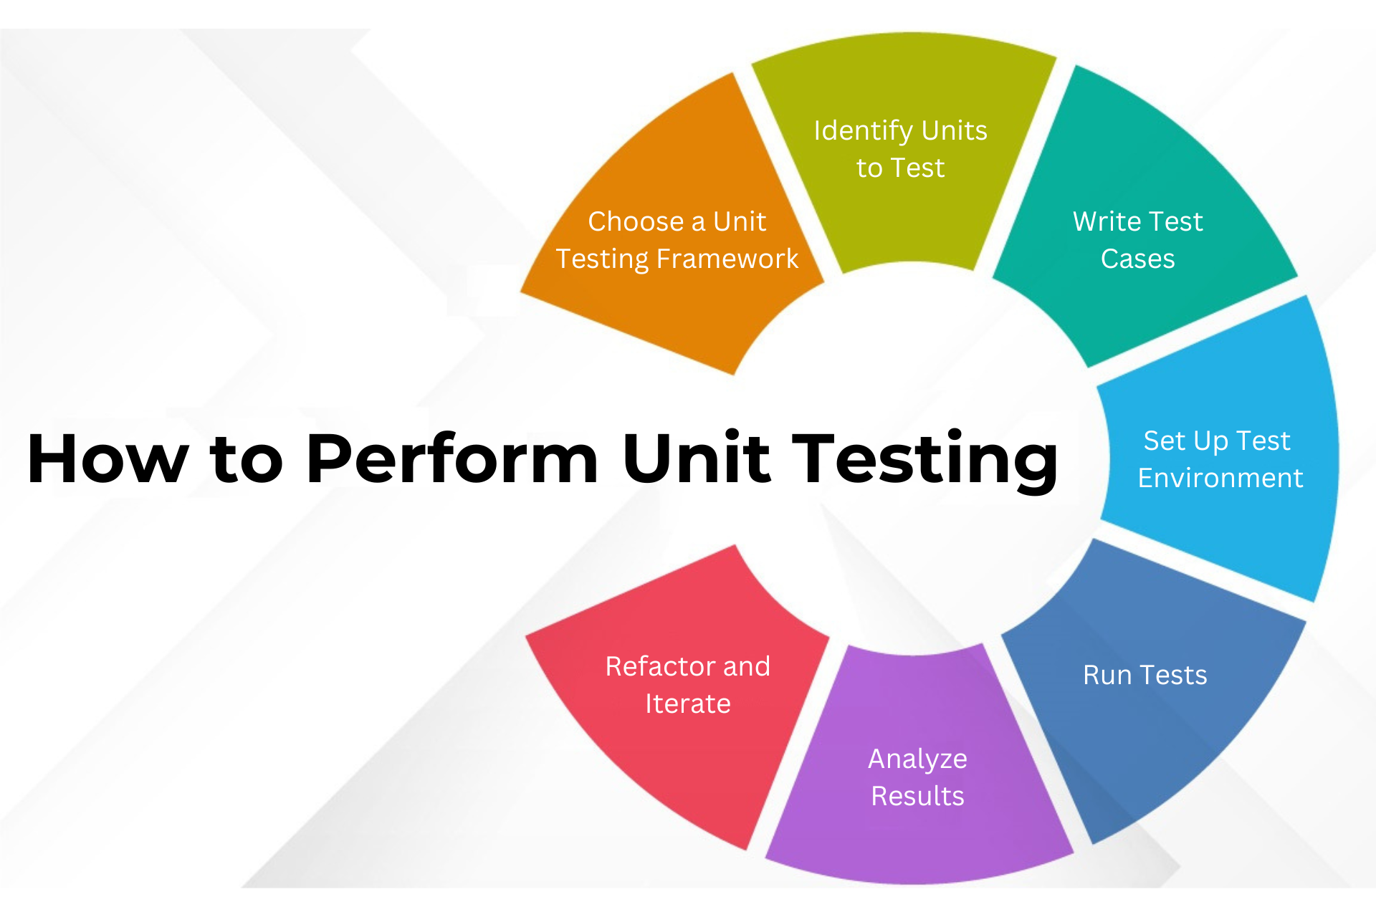
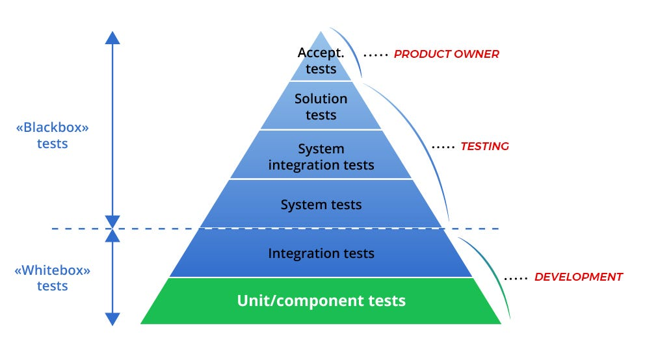
1.Excute Unit Test Cases To Analyze Code Performance :

Slide 6
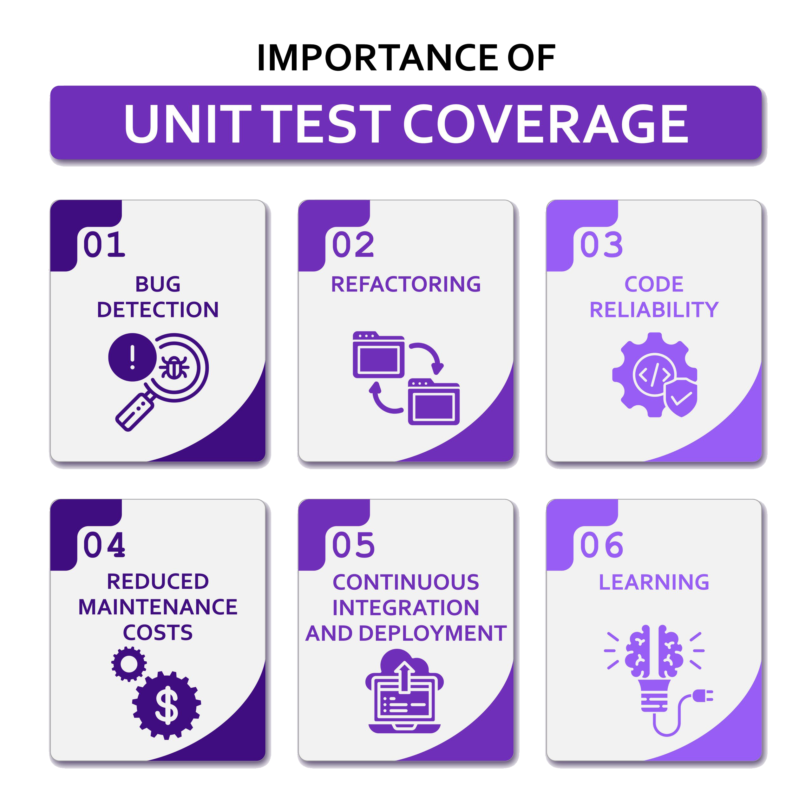
Analyze Coverage Of Unit Tests
The Most Basic Scenario Of Using Dotcover Is Measuring How Much Of Your Code Is Actually Executed When You Run Unit Tests. Baseline Conditions Are As Follows: You Have A Solution Opened In Jetbrains Rider And Code In The Solution Is Covered With Some Unit Tests. The Task Is To Understand How Much Of The Code Is Covered.

Slide 7

2.Devlopment Automated Test Cases Using Test automation Tools Such As Salenium

Slide 8
Software Testing: Automating Test Cases with Selenium
Selenium Is A Popular Open-source Test Automation Framework That Can Be Used To Automate Web Applications Across Different Browsers And Platforms. It Provides A Comprehensive Set Of Apis And Tools That Enable Testers To Write Scripts To Automate Various Tasks, Such As;
1.Navigating to web pages
2.Entering data into forms
3.Clicking on buttons and links
4.Verifying the content of web pages
Automating Test Cases With Selenium Can Help Testers To Save Time And Resources, Improve The Quality Of Testing, And Achieve Faster Test Cycles.

Slide 9
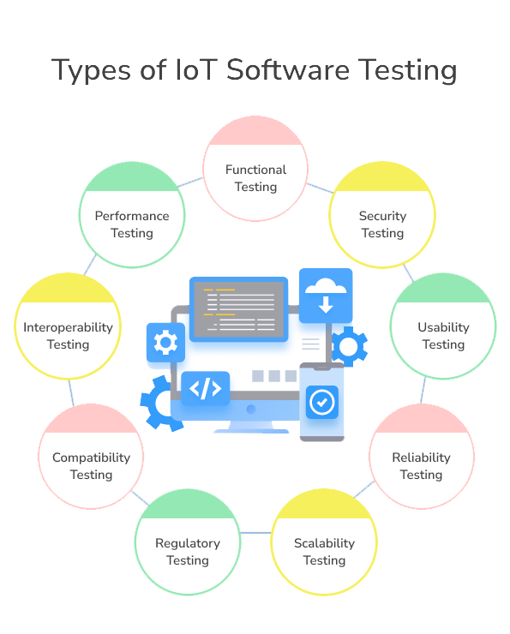
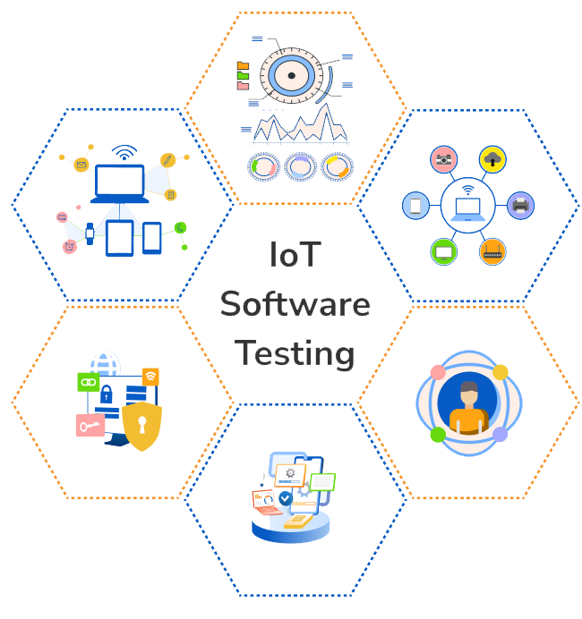
3.Refine Software Code Based On Test Results
TYPES OF TESTING FLOWCHAT:

Slide 10
Types Of Testing
Functional Testing:This Checks Whether The Iot Device Is Working As Intended.
Performance Testing: This Examines The Speed, Responsiveness, And Stability Of An Iot System Under A Particular Workload.
Security Testing: Given That Iot Devices Are Often Connected To The Internet, They Can Be Vulnerable To Attacks.
Interoperability Testing: This Ensures That Iot Devices Can Effectively Communicate And Operate With Other Devices Or Systems.
Scalability Testing: As The Number Of Devices Connected To The Iot Network Can Grow Rapidly, It's Important To Test If The System Can Handle This Growth.
Usability Testing: This Focuses On The User's Experience. It Checks The System's Ease Of Use, Intuitiveness, And Overall User Interface.
Compatibility Testing: This Testing Ensures That The Iot Device Can Operate Effectively In Different Environments And With Different Hardware, Operating Systems, Network Configurations, Etc.
Reliability Testing: This Verifies That The Iot Device Can Perform A Task Consistently Over Time Without Failure.
Regulatory Testing: This Is Often A Part Of Iot Testing Because Iot Devices Frequently Collect And Store Personal Data, Like Health Stats Or Information About Home Habits.

Slide 11

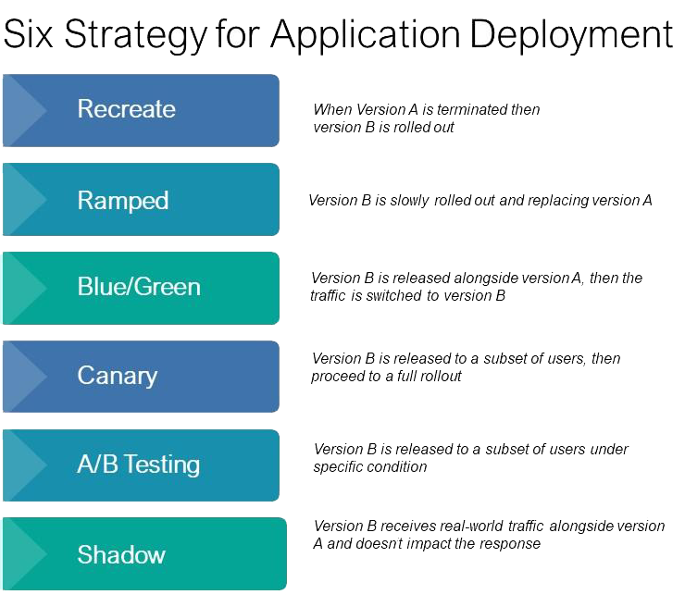
4.Plan Deployment Strategy For The Application
Six Strategy For Deployment Application:
What Is A Deployment Strategy?
If You Don’t Work In IT Or Software Development, The Term “Deployment” May Not Be In Your Typical Work Vernacular. Its Definition, Though, Is Pretty Simple – The Transfer Of Data Or Functionality From One Environment To Another. When A Development Team Or IT Makes A Change To Your Business Systems, They Shift These Updates From A Development Or Testing Environment To The One You Use – The Live Product.

Slide 12
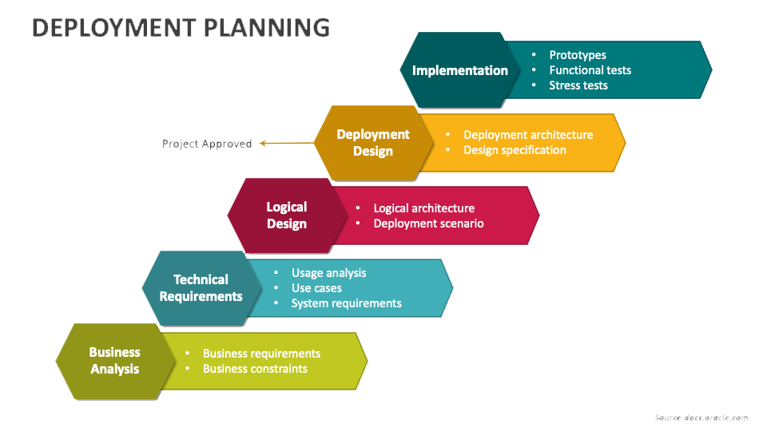
What Is Deployment Planning?

Slide 13
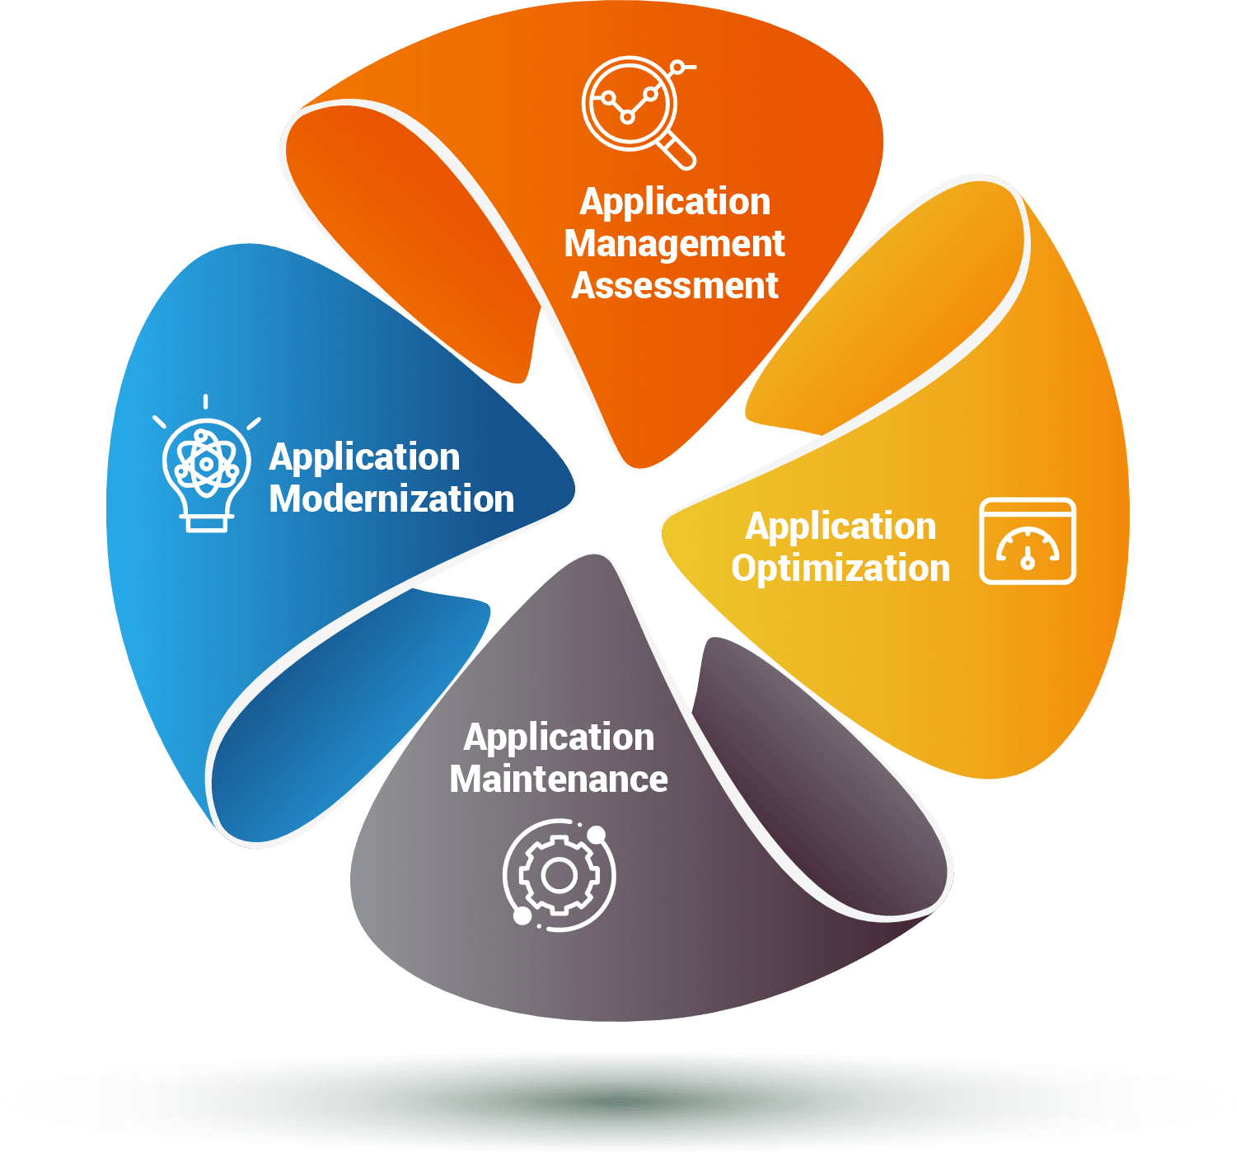
5.Leverage Application Monitoring And Management Services To Provide Continuous Support
LOVERAGE APPLICATION MANAGEMENT:
1.What Is Application Management?
Application Managed Services, Often Referred To As AMS, Are A Type Of IT Service Where A Third-party Provider Takes Responsibility For Managing And Maintaining An Organization’s Software Applications. This Allows The Organization To Focus On Its Core Business Activities While Ensuring That Their Applications Run Smoothly And Efficiently.
(AMS) Providers Offer A Wide Range Of Services Related To Application Management, Including Monitoring, Maintenance, Support, Updates, And Enhancements.

Slide 14
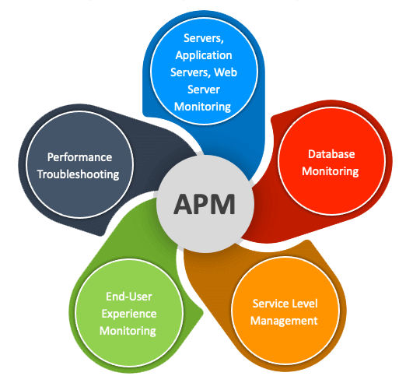
LEVERAGE APPLICATION MONITORING:
2.What Is Application Monitoring?
Application Monitoring Is The Process Of Monitoring An Application's Performance, Availability, And End-user Experience To Ensure The Application Is Functioning Properly. Real-time Application Performance Monitoring (APM) Enables Companies To Identify Issues Before They Impact Real Customers And Optimize Apps To Exceed User Expectations. With Customer Or User Experience Being A Core Focus For Today's Businesses, APM Is Crucial To Providing A Rewarding User Experience And Preventing Customer Service Issues Or Complaints.

Slide 15
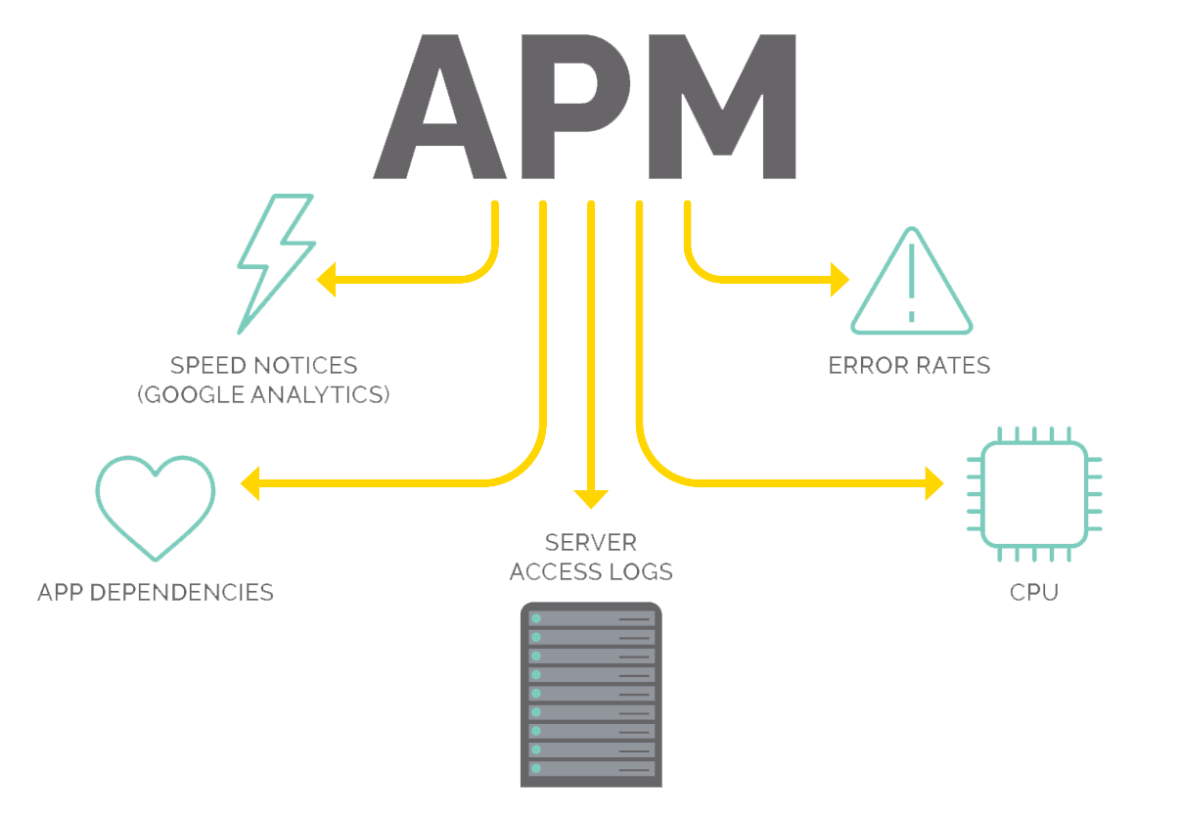
Why APM Is Important? In Today’s Fast-paced Digital World, Businesses Rely Heavily On Software Applications For Their Day-to-day Operations. Ensuring These Applications Perform Optimally Is Crucial For Delivering A Seamless User Experience And Maintaining A Competitive Edge. APM Plays A Vital Role In:
Improving End-user Experience
Reducing Downtime And Enhancing System Availability
Identifying And Resolving Performance Bottlenecks
Facilitating Effective Resource Allocation
Supporting Agile Development And Continuous Integration

Slide 16
6. Collaborate With Vendors To Identify Responsibilities That Can Be Carried By Them On An On-going Basis, Such As Bug-fixes, Enhancements ,and Release Of Patches
Collaboration with vendors :
Once you've taken the time to segment your vendors, the next step is to consider closer collaboration with those that you've identified as being key to the success of your business.
At A High Level, The Main Reasons For This Are Because You'll Want To:
Reduce costs
Make process improvements
Encourage innovation in products or services
PROCESS: Selecting Vendors, Negotiating Contracts, Controlling Costs, Reducing Vendor-related Risks And Ensuring Service Delivery.

Slide 17
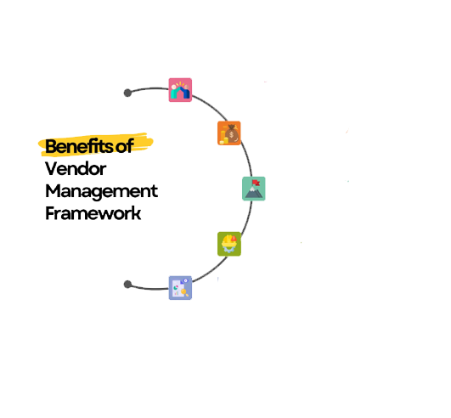
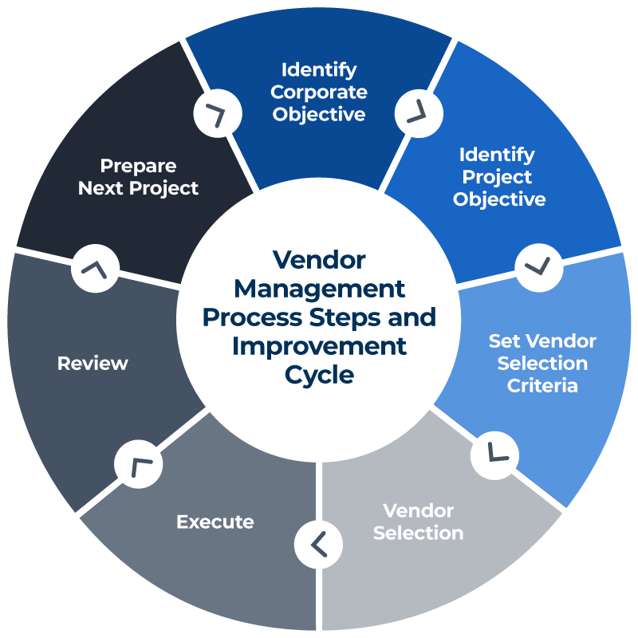
Vendor Benefits, process And Improvement Cycle:
Strength Vendor
Relationship
Increasing Efficiency
And Cost Savings.
Aligned With
Organized Goals
Better Risk
Management
Increasing Transparency
And Accontability

Slide 18
UNDERSTANDING THE PATCH RELEASE PROCESS ;
At the highest level, the overall patch process for a software vendor is as follows:
(1) A software vendor learns that part of a program is not working as intended (a bug) or identifies an attack possibility (a vulnerability);
(2) The software vendor develops a patch to eliminate the bug or vulnerability;
(3) The software vendor releases the patch through the internet and notifies their customers; and
(4) customers are left to test and implement the patch for end users.
What Is The Difference Between A Bug And An Enhancement?
For example, if you go to a restaurant and order an item on the menu and they tell you they cannot make that item for you => that is a bug; if instead you ask them to make a special order that is not on the menu => that is a enhancement.

Slide 19
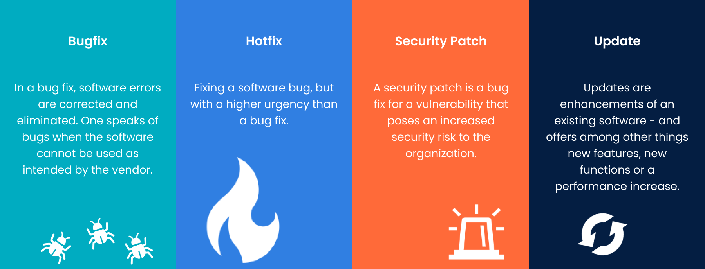
Bug-fixes, Enhancements ,and Release Of Patches
What Are The Three Types Of Patch Management?
Bug Fix Patches:
The Three Most Common Types Of Patches Are ;
1.Security Patches,
2.Bug Fixes, And
3.Feature Updates
SECURITY PATCHES:One of the reasons why patch management is so important is due to how quickly the technology sector can move.
BUG-FIXING PATCHES:Other important types of patches are ones that fix application errors and common or uncommon bugs encountered during regular use of the systems.
FEATURE PATCHES:Modern Software Companies Are In A Never ending Arms Race To Provide The Best Applications On The Market.
Patches-perseus (symbol)

Slide 20
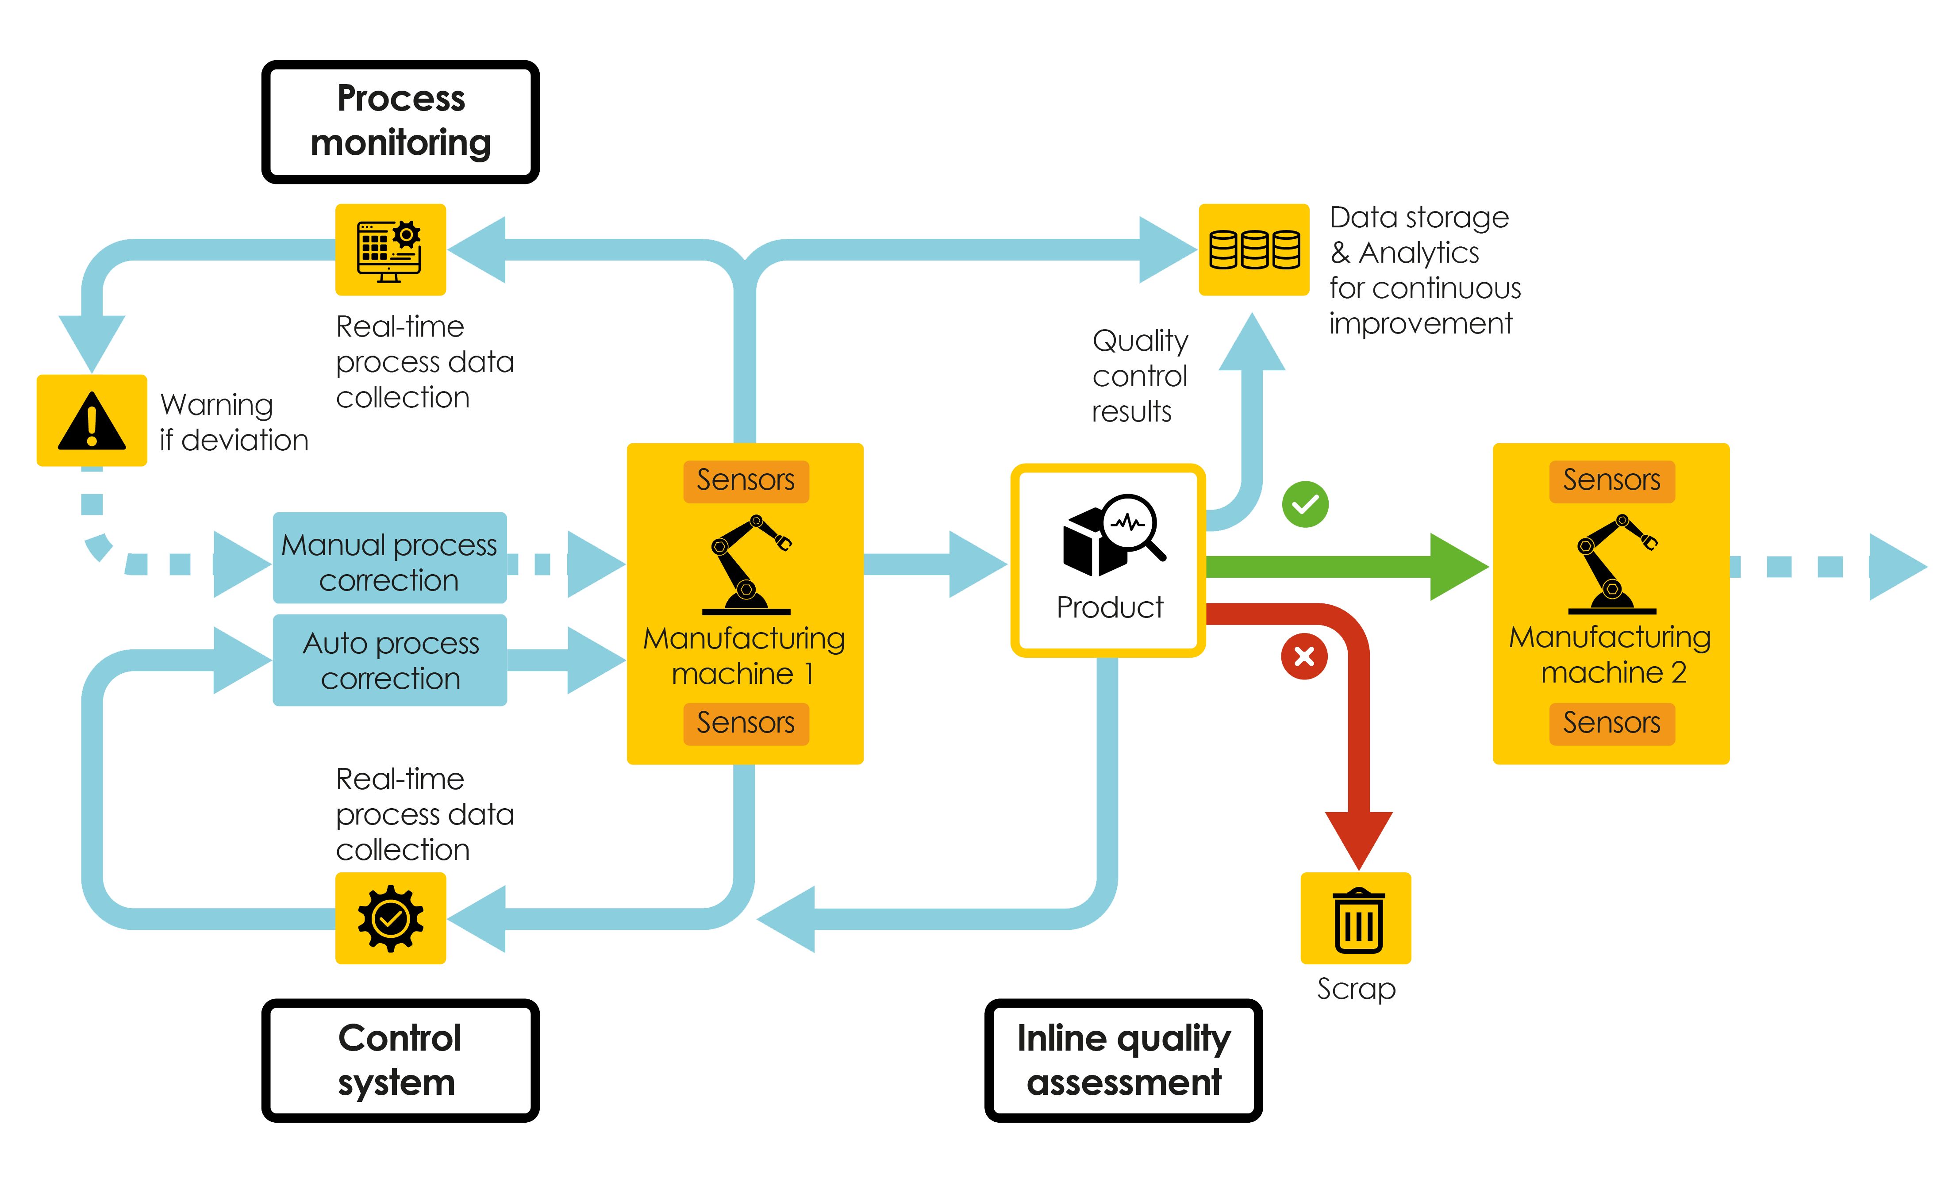
7.Setup Process For Monitoring And Upgrading The Application On A Contains

Slide 21
Upgrade Monitor Overview:
The Upgrade Monitor Helps You Upgrade An Individual Instance.
You Can Monitor The Progress Of An Upgrade And Resolve Conflicts Between
the Upgrade And Customizations.
SET UP FOR THE UPGRADE MONITOR:
Washington DC, the Upgrade Monitor is installed by default.
If you log in with the admin role while an upgrade is underway, the system automatically displays the Upgrade Progress screen. If no upgrade is in progress, you can navigate to System Diagnostics > Upgrade Monitor.
UPGRADE MONITOR MODULE:
Schedule an upgrade and monitor the status of an ongoing upgrade using the Upgrade Monitor module. You can also view the upgrade summary and the list of records causing conflicts in your instance once the upgrade is complete.

Slide 22
System Monitor Upgrade
The System Monitor Package Manager Enables A Logrhythm Administrator To Schedule Automatic Updates For Multiple System Monitors At One Time. Using The System Monitor Package Manager, The Administrator Can Load An Update Package To The Logrhythm Client Console And Then Schedule It To Be Applied At A Future Date And Time. When The System Monitors Receive The Package, They Shut Down, Update, And Then Restart Automatically. Administrators Can Use The System Monitor Package Manager To Upgrade Or Downgrade System Monitors.
ACCESS UPGRADE MONITOR
*If you log in with the admin role while an upgrade is underway,
*The system automatically displays the Upgrade Progress screen. If no upgrade is in progress,
Navigateto All > UpgradCenter > Upgrade Monitor.
UPGRADE HISTORY MODULE
*The Upgrade History Module Tracks Every Upgrade Made To An Instance.
*You Can Also View The Complete Report Of An Old Upgrade Or A Recently Completed Upgrade Version Using This module.
All >upgrade center>Upgrade history

Slide 23
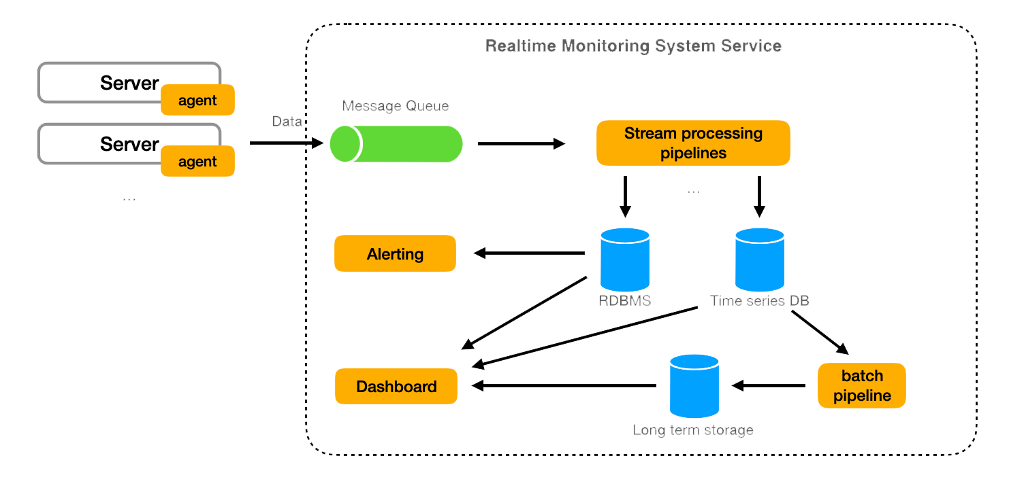

Design For Realtime Monitoring System

Slide 24


